Slide 1
FastTrack for Dynamics 365
Test Strategy Workshop

Slide 2
Test Strategy Workshop Agenda
Agenda
Reiterate the purpose and objectives of this workshop to ensure all attendees have a common understanding.
Objective of the Test Strategy: To provide the necessary direction and planning to ensure that the testing regimen is appropriate to the project scope, business needs and risks.
Objective of this workshop: To confirm that the Test Strategy for this project adequately addresses the project scope and related business risks prior to production use.
Purpose and objectives
Overall Test Strategy
Project Scope mapped to Testing Scope
Test Plan
Test Phases and Test Types
​ Specific Test Phases and Test Types
Tools
Format: 120-minute Microsoft Teams call
Attendees:. Customer and partner: PMs, Solution Architect(s), Test Manager(s) are mandatory
Q&A
Next Steps and Agreed Actions

Slide 3
Overall Test Strategy

Slide 4
Overall Test Strategy
Customer slide (please update)
Define the overall Test Strategy and approach
Add Info: A summary of the key areas of your Test Strategy

Slide 5
Project Scope mapped to Testing Scope

Slide 6
Project scope mapped to Testing scope
Customer slide (please update)
Identify the testing scope based on the project scope
Add Info: Consider all the various types of project scope. See some areas to consider here: Project scope mapped to Testing scope
List any relevant scope areas not clearly covered in the Test Strategy
Add Info

Slide 7
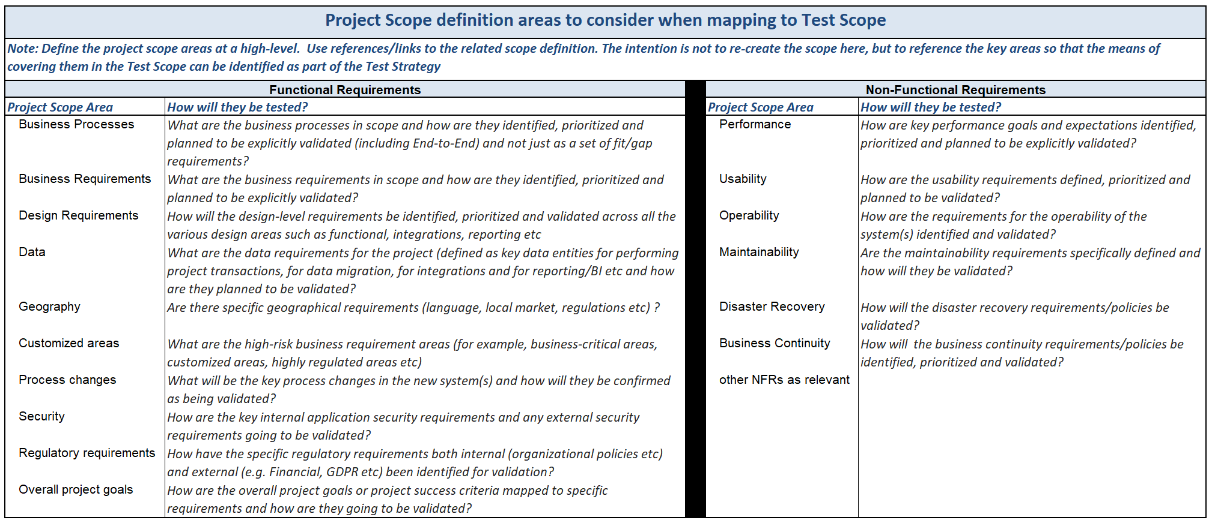
Project scope mapped to Testing scope
Example/Guide slide
Consider the following areas of your project scope and see how they are mapped to your testing scope

Slide 8
Test Plan

Slide 9
High-level Test Plan
Customer slide (please update)
How are the key test phases and test types represented in the Project plan?
Add Project plan related to testing (include key dependent milestones)

Slide 10
Test Phases and Test Types

Slide 11
Testing types and phases
Customer slide (please update)
What are the key test phases (SIT, UAT etc), and what are the related milestones?
Add Info
List any other tests, functional and non-functional (unit testing, performance testing, data testing etc) that are planned
Add Info

Slide 12
Test Definition & Test Management considerations
Customer slide (please update)
How are the tests defined, prioritized, planned and the testing preparation, execution and reporting managed?
What are the common patterns or strategies across all the tests? (For specific details per Test Phase/Test Type use the detailed test slides). See the “Example/Guide” slide for the list of areas to consider: Test Definition & Test Management considerations

Slide 13
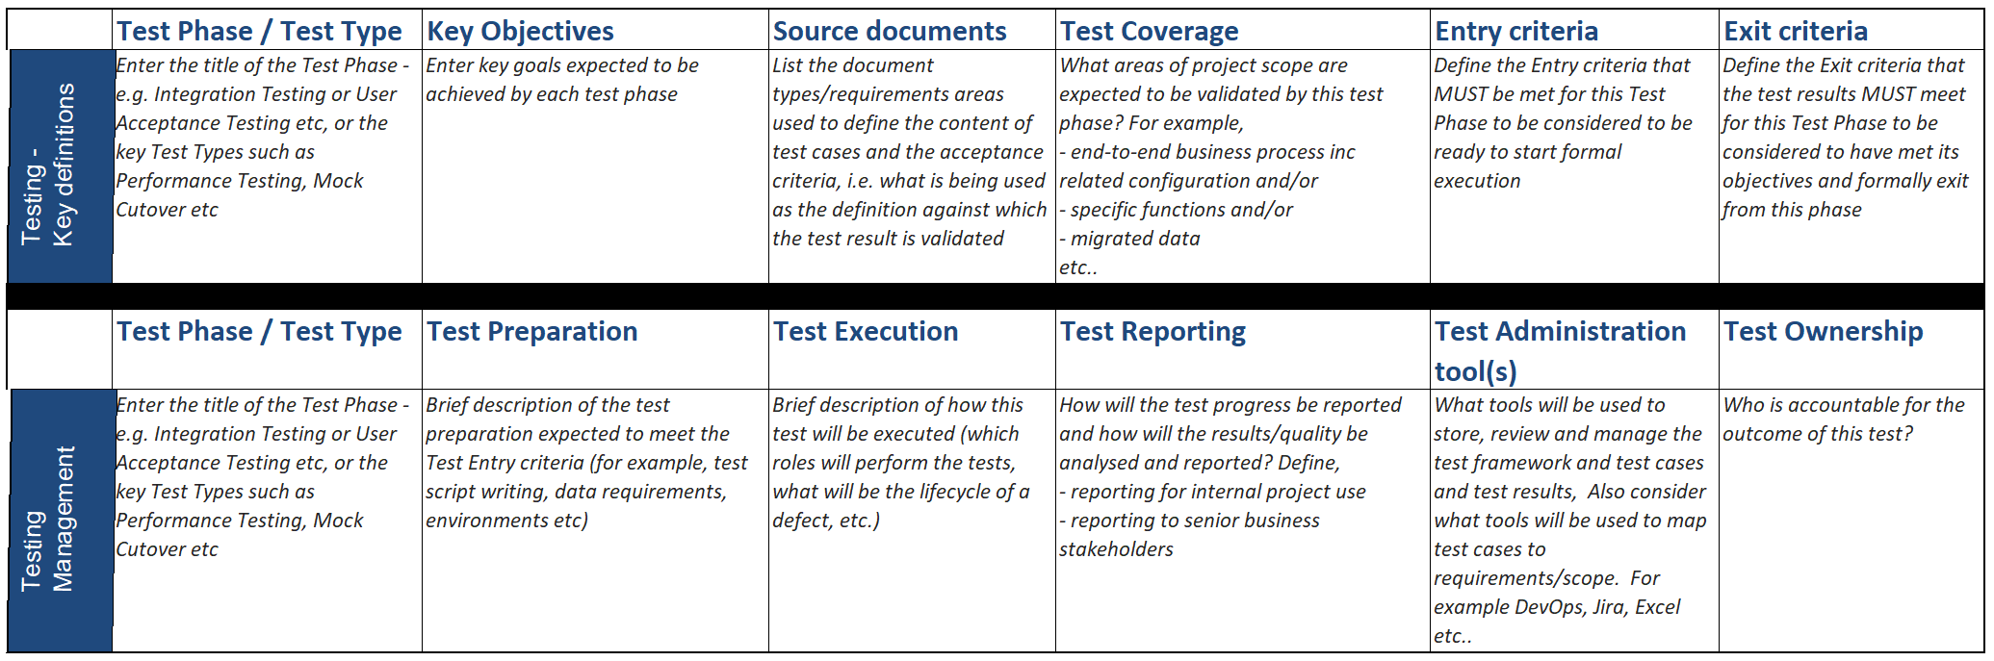
Test Definition & Test Management considerations
Example/Guide slide
How is testing defined, planned and its execution and reporting managed?

Slide 14
Unit Testing

Slide 15
Unit Testing
Customer slide (please update)
How is Unit Testing defined, prioritized, planned and the testing preparation, execution and reporting managed?
Consider the objectives of this test, what project scope this test covers, the entry/exit criteria and the test management process for this specific test. See the “Example/Guide” slide for the list of areas to consider: Test Definition & Test Management considerations

Slide 16
Functional/Process Testing

Slide 17
Functional/Process Testing
Customer slide (please update)
How is Functional/Process Testing defined, prioritized, planned and the testing preparation, execution and reporting managed?
Consider the objectives of this test, what project scope this test covers, the entry/exit criteria and the test management process for this specific test. See the “Example/Guide” slide for the list of areas to consider: Test Definition & Test Management considerations

Slide 18
System Integration Testing

Slide 19
System Integration Testing
Customer slide (please update)
How is System Integration Testing defined, prioritized, planned and the testing preparation, execution and reporting managed?
Consider the objectives of this test, what project scope this test covers, the entry/exit criteria and the test management process for this specific test. See the “Example/Guide” slide for the list of areas to consider: Test Definition & Test Management considerations

Slide 20
End-to-End Testing

Slide 21
End-to-End Testing
Customer slide (please update)
How is End-to-End Testing defined, prioritized, planned and the testing preparation, execution and reporting managed?
Consider the objectives of this test, what project scope this test covers, the entry/exit criteria and the test management process for this specific test. See the “Example/Guide” slide for the list of areas to consider: Test Definition & Test Management considerations

Slide 22
User Acceptance Testing

Slide 23
User Acceptance Testing
Customer slide (please update)
How is User Acceptance Testing defined, prioritized, planned and the testing preparation, execution and reporting managed?
Consider the objectives of this test, what project scope this test covers, the entry/exit criteria and the test management process for this specific test. See the “Example/Guide” slide for the list of areas to consider: Test Definition & Test Management considerations

Slide 24
Regression Testing

Slide 25
Regression Testing
Customer slide (please update)
How is Regression Testing defined, prioritized, planned and the testing preparation, execution and reporting managed?
Consider the objectives of this test, what project scope this test covers, the entry/exit criteria and the test management process for this specific test. See the “Example/Guide” slide for the list of areas to consider: Test Definition & Test Management considerations

Slide 26
Non-Functional Testing - Performance

Slide 27
Performance Testing
Customer slide (please update)
How is Performance Testing defined, prioritized, planned and the testing preparation, execution and reporting managed?
Consider the objectives of this test, what project scope this test covers, the entry/exit criteria and the test management process for this specific test. See the “Example/Guide” slide for the list of areas to consider: Test Definition & Test Management considerations

Slide 28
Non-Functional Testing - Data

Slide 29
Data Testing
Customer slide (please update)
How is Data Testing defined, prioritized, planned and the testing preparation, execution and reporting managed?
Consider the objectives of this test, what project scope this test covers, the entry/exit criteria and the test management process for this specific test. See the “Example/Guide” slide for the list of areas to consider: Test Definition & Test Management considerations

Slide 30
Non-Functional Testing - Security

Slide 31
Security Testing
Customer slide (please update)
How is Security Testing defined, prioritized, planned and the testing preparation, execution and reporting managed?
Consider the objectives of this test, what project scope this test covers, the entry/exit criteria and the test management process for this specific test. See the “Example/Guide” slide for the list of areas to consider: Test Definition & Test Management considerations

Slide 32
Test Tooling

Slide 33
Tooling – Dynamics 365 CE
Customer slide (please update)
What tool(s) will be used for Testing?
Have you considered any whitepaper associated with the tool for best practices, known issues?
Yes/No
What use of Automated and manual testing with Azure Plan (DevOps) have you planned?:
What use of Easy Repro for UI testing for Dynamics 365 have you planned?
Notes:
=========================
Why are we asking this information?
To understand if there are any specific tools in use
=========================
What we’ll do with this information?
If you are not using any tools, we can provide you suggestions followed by other customers
Provide you links to our tools:
Easy Repro – Getting Started
https://community.dynamics.com/crm/b/crminthefield/posts/test-automation-and-easyrepro-01---overview-and-getting-started
Automated and Manual Testing with Azure Test Plan (DevOps)
https://www.youtube.com/watch?v=LF0hmSysWCg
EasyRepro in 60 Seconds
http://xrmenterprise.com/2020/03/easyrepro-in-60-seconds/
=========================
FAQ:

Slide 34
Tooling – Dynamics 365 F&O
Customer slide (please update)
What automation or other tool(s) will be used for Testing ?
Add a description of tooling for the various test types such as Unit Testing, Functional Testing, Performance Testing etc?
What use of RSAT for regression testing have you planned?:

Slide 35
Q&A and Next Steps

Slide 36
Q&A
Brief Q&A to discuss any additional topic areas.
List questions and follow up actions

Slide 37
Next Steps and Agreed Actions
Discuss next steps and agreed action items.
List next steps and action items

Slide 38

© 2020 Microsoft Corporation. All rights reserved. Microsoft, Microsoft Dynamics, Office 365, Windows, and other product names are or may be registered trademarks and/or trademarks in the U.S. and/or other countries. The information herein is for informational purposes only and represents the current view of Microsoft Corporation as of the date of this presentation. Because Microsoft must respond to changing market conditions, it should not be interpreted to be a commitment on the part of Microsoft, and Microsoft cannot guarantee the accuracy of any information provided after the date of this presentation. MICROSOFT MAKES NO WARRANTIES, EXPRESS, IMPLIED OR STATUTORY, AS TO THE INFORMATION IN THIS PRESENTATION

